Slide 1
RL introduction and AlphaGo
陳慶豐

Slide 2
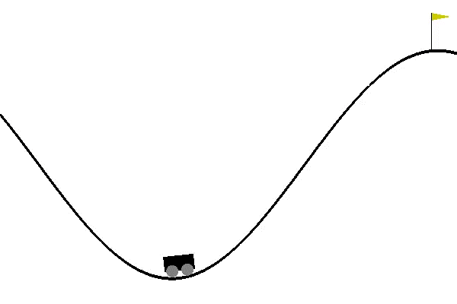
What is reinforcement learning?
State:
1. Car position
2. Car velocity
Action:
1. Accelerate to the Right
2. Accelerate to the Left
Reward:
0 is awarded if the agent reached the flag
-1 is awarded if the agent doesn’t reach the flag
Agent
$$\left(s_{0}, a_{0}, r_{0}\right)→\left(s_{1}, a_{1}, r_{1}\right)→\left(s_{2}, a_{2}, r_{2}\right)→…→\left(s_{n}, a_{n}, r_{n}\right)$$
Q1: How to model these kind of problem?
Q2: How to handle exploration/exploitation trade off?
Notes:
這跟一般的問題不太依樣，例如說我們在train CNN的時候，我們把一張圖片丟到模型中就可以很立即性的去跟正確答案對答案。
但是這種問題你需要透過一個sequence of action，才能得到最終的結果:贏或是輸。或是像是下圍棋，這種需要透過一連串的行為與環境去互動，才能得到結果的問題，就是在中間的的步驟，每個行為能得到的暗示 是很少的，那我們要怎麼去幫中間的步驟訂製它的價值，進而找到一個policy去使得在每個state，我們可以找到一個action，可以使得你的勝率最終勝率最高，這就是我們今天要回答的第一個問題。
而當我們觀察，例如說這個過山車的例子，我們需要一些隨機性去探索可能性，但是我們也需要保留一些好的猜測，去引導我們比較快走到終點，那個exploration 跟 explotation之間，我們要怎麼

Slide 3
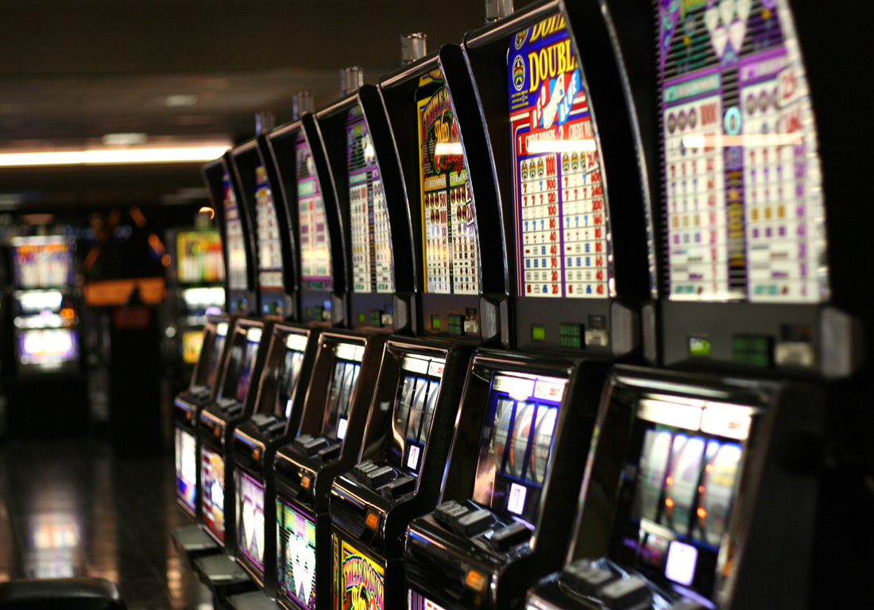
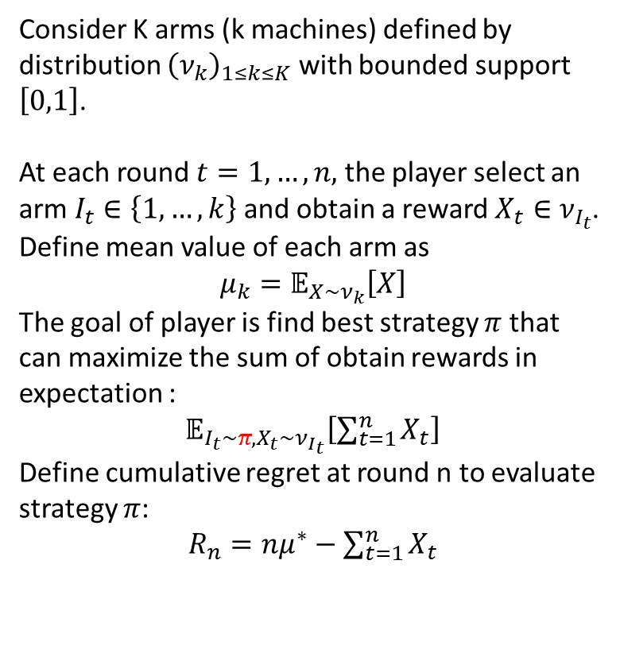
Multi-armed bandit problem
Consider K arms (k machines) defined by distribution ${\left(ν_{k}\right)}_{1≤k≤K}$ with bounded support $\left[0,1\right]$.
At each round $t=1,…,n,$ the player select an arm $I_{t}∈\left\{1,…,k\right\}$ and obtain a reward $X_{t}∈ν_{I_{t}}$.
Define mean value of each arm as
$$μ_{k}=𝔼_{X∼ν_{k}}\left[X\right]$$
The goal of player is find best strategy $π$ that can maximize the sum of obtain rewards in expectation :
$𝔼_{I_{t}∼π, X_{t}∼ν_{I_{t}}}\left[\sum_{t=1}^{n}{X_{t}}\right]$
Define cumulative regret at round n to evaluate strategy $π$:
$R_{n}=nμ^{∗}−\sum_{t=1}^{n}{X_{t}}$

Slide 4



What is reinforcement learning?

Slide 5
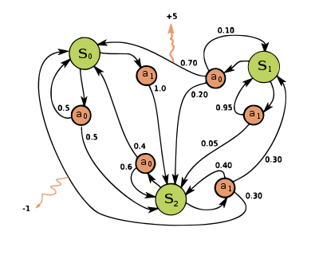


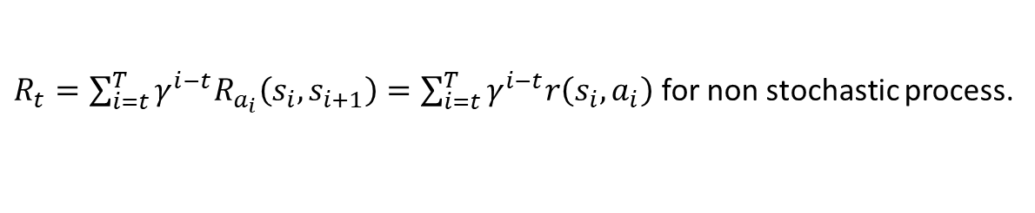

Markov decision process (MDP)
MDP is defined by a tuple: $<S, A, R_{a}, P_{a}, γ>$
$S$ is a set of states called the state space
$A$ is a set of actions called the action space
$P_{a}\left(s,s′\right)=P\left(s_{t+1}=s|s_{t}=s,a_{t}=a\right)$
$R_{a}\left(s,s′\right):$ reward get from state $s$ to $s′$
$γ∈\left(0,1\right)$ a discount value
Given an policy $π\left(a | s\right)=P\left(A_{t}=a|S_{t}=s\right)$
we can form a sequence:
$$\left(s_{0}, a_{0}, r_{0}\right)→\left(s_{1}, a_{1}, r_{1}\right)→\left(s_{2}, a_{2}, r_{2}\right)→…→\left(s_{n}, a_{n}, r_{n}\right)$$
Define total reward as:
$R_{t}=\sum_{i=t}^{T}{γ^{i−t}R_{a_{i}}\left(s_{i},s_{i+1}\right)}=\sum_{i=t}^{T}{γ^{i−t}r\left(s_{i},a_{i}\right)}$ for non stochastic process.
Then the goal of RL is to learn $π$ to maximize $R_{1}$:
$$\underset{π}{argmax}{J=}\underset{π}{argmax}{𝔼_{r_{i},s_{i}∼E, a_{i}∼π}\left[R_{1}\right]}$$
Notes:
那我們應該會很好奇，為什麼這個total reward，他需要用一個discount

Slide 6
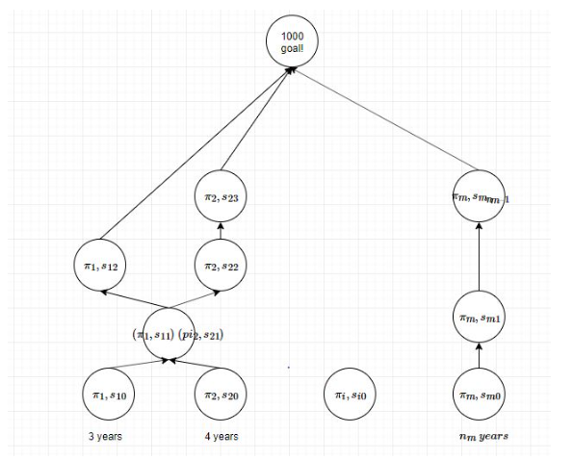

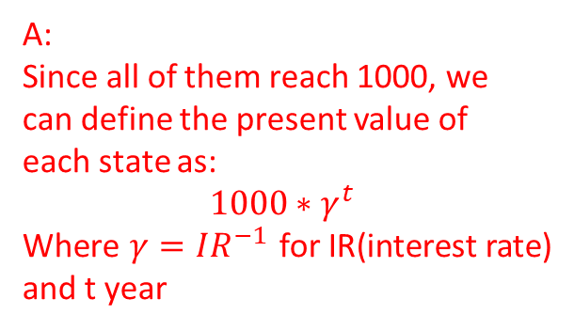








Core idea of RL: Present value.
Bank
Interest:$γ^{−1}$
Q:
How can we define the present value of each state?
A:
Since all of them reach 1000, we can define the present value of each state as:
$$1000∗γ^{t}$$
Where $γ=IR^{−1}$ for IR(interest rate)
and t year
$$1000∗γ$$
$$1000∗γ$$
$$1000∗γ$$
$$1000∗γ^{2}$$
$$1000∗γ^{2}$$
$$1000∗γ^{3}$$
$$1000∗γ^{3}$$
$$1000∗γ^{4}$$
$$1000∗γ^{n_{m}}$$

Slide 7
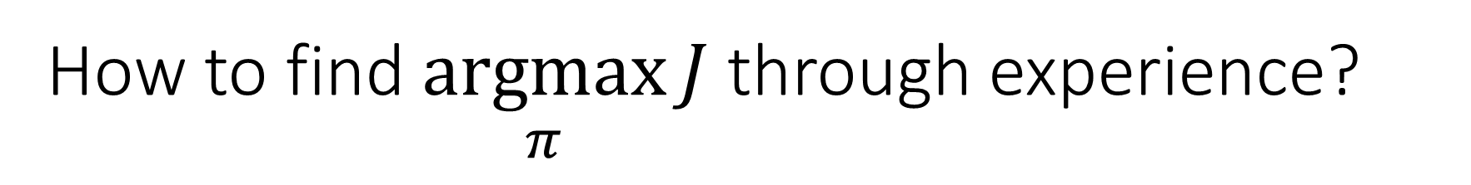
How to find $\underset{π}{argmax}{J}$ through experience?
State:
1. Car position
2. Car velocity
Action:
1. Accelerate to the Right
2. Accelerate to the Left
Reward:
0 is awarded if the agent reached the flag
-1 is awarded if the agent doesn’t reach the flag
Agent
$\left(S, A, R\right):\left(s_{0}, a_{1}, r_{1}\right)→\left(s_{1}, a_{2}, r_{2}\right)→\left(s_{2}, a_{3}, r_{3}\right)→…→\left(s_{n}, a_{n}, r_{n}\right)$
$\left(s_{1}^{1}, a_{1},^{1}r_{1}^{1}\right)→\left(s_{2}^{1},a_{2}^{1}, r_{2}^{1}\right)→\left(s_{3}^{1}, a_{3}^{1}, r_{3}^{1}\right)→…→\left(s_{n}^{1},a_{n}^{1}, r_{n}^{1}\right)$: success
…
$\left(s_{1}^{n}, a_{1}^{n}, r_{1}^{n}\right)→\left(s_{2}^{n}, a_{2}^{n}, r_{2}^{n}\right)→\left(s_{3}^{n}, a_{3}^{n}, r_{3}^{n}\right)→…→\left(s_{m}^{n},a_{m}^{n}, r_{m}^{n}\right)$: fail
Notes:
假設今天我們今天已經收集到了一些

Slide 8

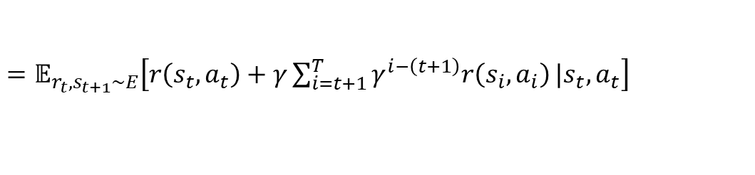
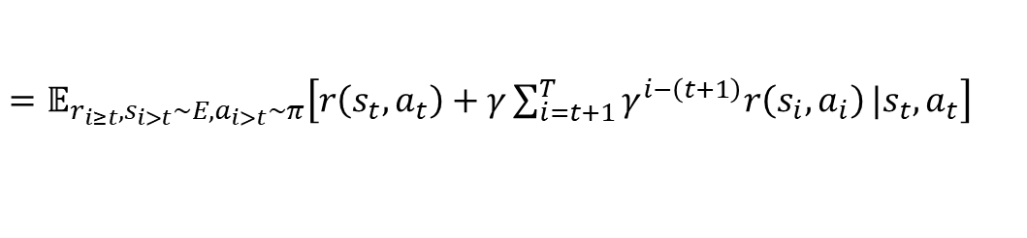
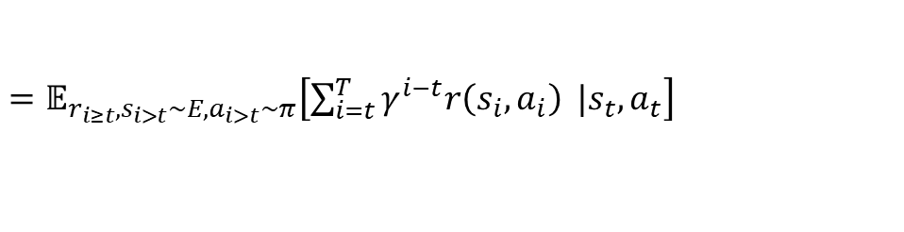

Action value function Q
Given a policy $π$
Define the action value function $Q^{π}$ as:
$Q^{π}\left(s_{t},a_{t}\right)=𝔼_{r_{i≥t},s_{i>t}∼E, a_{i>t}∼π}\left[R_{t}|s_{t}, a_{t}\right]$
$=𝔼_{r_{i≥t},s_{i>t}∼E, a_{i>t}∼π}\left[\sum_{i=t}^{T}{γ^{i−t}r\left(s_{i},a_{i}\right)} |s_{t}, a_{t}\right]$
$=𝔼_{r_{i≥t},s_{i>t}∼E, a_{i>t}∼π}\left[r\left(s_{t},a_{t}\right)+γ\sum_{i=t+1}^{T}{γ^{i−\left(t+1\right)}r\left(s_{i},a_{i}\right)}|s_{t}, a_{t}\right]$
$=𝔼_{r_{t},s_{t+1}∼E}\left[r\left(s_{t},a_{t}\right)+γ\sum_{i=t+1}^{T}{γ^{i−\left(t+1\right)}r\left(s_{i},a_{i}\right)}|s_{t}, a_{t}\right]$
$=𝔼_{r_{t}∼E}\left[r\left(s_{t},a_{t}\right)\right]+γ𝔼_{a_{t+1}∼π}\left[Q^{π}\left(s_{t+1},a_{t+1}\right)\right]$
Suppose the given $s_{t+1}∼\left(s_{t},a_{t}\right)$is not stochastic, then we have:
$=r\left(s_{t},a_{t}\right)+γ𝔼_{a_{t+1}∼π}\left[Q^{π}\left(s_{t+1},a_{t+1}\right)\right]$
This is what we want to find!

Slide 9

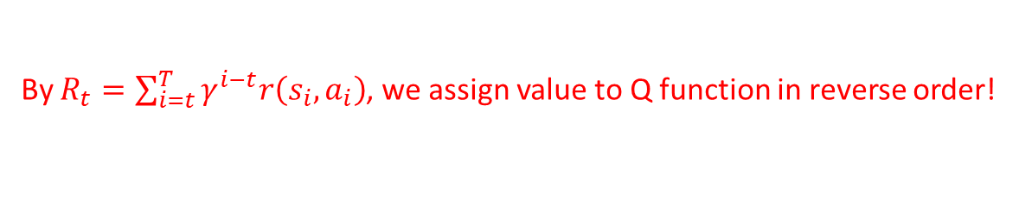






Action value function Q: example
Given a policy $π$
Define the action value function $Q^{π}$ as:
$Q^{π}\left(s_{t},a_{t}\right)=r\left(s_{t},a_{t}\right)+γ𝔼_{a_{t+1}∼π}\left[Q^{π}\left(s_{t+1},a_{t+1}\right)\right]$
$\left(s_{1}^{1}, a_{1},^{1}r_{1}^{1}\right)→\left(s_{2}^{1},a_{2}^{1}, r_{2}^{1}\right)→\left(s_{3}^{1}, a_{3}^{1}, r_{3}^{1}\right)→…→\left(s_{n}^{1},a_{n}^{1}, r_{n}^{1}\right)$: success
…
$\left(s_{1}^{n}, a_{1}^{n}, r_{1}^{n}\right)→\left(s_{2}^{n}, a_{2}^{n}, r_{2}^{n}\right)→\left(s_{3}^{n}, a_{3}^{n}, r_{3}^{n}\right)→…→\left(s_{m}^{n},a_{m}^{n}, r_{m}^{n}\right)$: fail
By $R_{t}=\sum_{i=t}^{T}{γ^{i−t}r\left(s_{i},a_{i}\right)}$, we assign value to Q function in reverse order!
$$Q^{π}\left(s_{n}^{1},a_{n}^{1}\right)=1$$
$$Q^{π}\left(s_{n}^{1},a_{n}^{1}\right)=1$$
$$Q^{π}\left(s_{n−1}^{1},a_{n−1}^{1}\right)=−1+γ∗1$$
$$Q^{π}\left(s_{n−1}^{1},a_{n−1}^{1}\right)=0+γ∗1$$
$$Q^{π}\left(s_{n−2}^{1},a_{n−2}^{1}\right)=−1+γ\left(−1+γ∗1\right)$$
$$Q^{π}\left(s_{n−2}^{1},a_{n−2}^{1}\right)=0+γ^{2}∗1$$
$$Q^{π}\left(s_{1}^{1},a_{1}^{1}\right)=γ^{n−1}∗1$$

Slide 10






Q-learning
4
Initialize $π$
2.5
Repeat (for each episode):
1. Given initial state $s_{0}$
2. Stimulate ${\left\{s_{t},a_{t},r_{t}\right\}}_{t=1…N}$ by $π$ and random step.
3
3. Add sequence ${\left\{s_{t},a_{t},r_{t}\right\}}_{t=1…N}$ to Q table.
4. Train Q function $Q\left(s_{t},a|θ^{Q}\right)$ to predict correct total reward
by minimizing
2
1.5
$L\left(θ^{Q}\right)=𝔼\left[{\left(Q\left(s_{t},a_{t}|θ^{Q}\right)−y_{t}\right)}^{2}\right]$
where $y_{t}=r\left(s_{t},a_{t}\right)+γQ\left(s_{t+1},μ\left(s_{t+1}\right)|θ^{Q}\right)$
-1
1
5. Set $π=\underset{a}{argmax}{Q\left(s_{t+1},a|θ^{Q}\right)}$
0

Slide 11
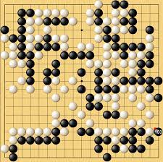

Alpha Go
$\left(s_{0}, a_{1}, r_{1}\right)→\left(s_{1}, a_{2}, r_{2}\right)→\left(s_{2}, a_{3}, r_{3}\right)→…→\left(s_{n}, a_{n}, r_{n}\right)$
$\left(s_{1}^{1}, a_{1},^{1}r_{1}^{1}\right)→\left(s_{2}^{1},a_{2}^{1}, r_{2}^{1}\right)→\left(s_{3}^{1}, a_{3}^{1}, r_{3}^{1}\right)→…→\left(s_{n}^{1},a_{n}^{1}, r_{n}^{1}\right)$: win
…
$\left(s_{1}^{n}, a_{1}^{n}, r_{1}^{n}\right)→\left(s_{2}^{n}, a_{2}^{n}, r_{2}^{n}\right)→\left(s_{3}^{n}, a_{3}^{n}, r_{3}^{n}\right)→…→\left(s_{m}^{n},a_{m}^{n}, r_{m}^{n}\right)$: loss
Train a $Q\left(s,a|θ^{Q}\right)$ and find which $a$ maximize $Q\left(s,a|θ^{Q}\right)$.
But what if we just can’t make good prediction through a single state?
If using brute force method, 19*19 GO board have about (361)! possibilities.
$$(19∗19)!≈{10}^{461}$$
How to estimate good $Q\left(s,a|θ^{Q}\right)$ through sampling important future?
How to balance the trade off between exploration and exploitation ?

Slide 12
Multi-armed bandit problem
Consider K arms (k machines) defined by distribution ${\left(ν_{k}\right)}_{1≤k≤K}$ with bounded support $\left[0,1\right]$.
At each round $t=1,…,n,$ the player select an arm $I_{t}∈\left\{1,…,k\right\}$ and obtain a reward $X_{t}∈ν_{I_{t}}$.
Define mean value of each arm as
$$μ_{k}=𝔼_{X∼ν_{k}}\left[X\right]$$
The goal of player is find best strategy $π$ that can maximize the sum of obtain rewards in expectation :
$𝔼_{I_{t}∼π, X_{t}∼ν_{I_{t}}}\left[\sum_{t=1}^{n}{X_{t}}\right]$
Define cumulative regret at round n to evaluate strategy $π$:
$R_{n}=nμ^{∗}−\sum_{t=1}^{n}{X_{t}}$

Slide 13
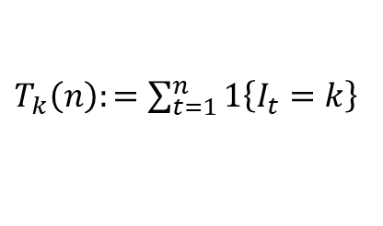

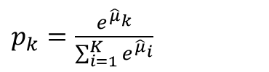
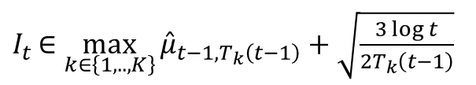




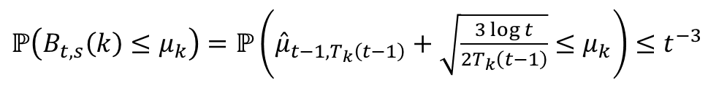

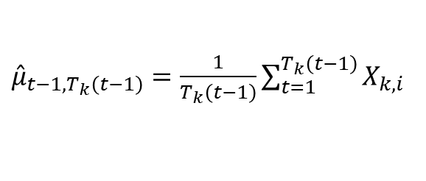

Proposed solutions
1. $π$-greedy exploration:
4. Upper confidence bounds algorithm
Best arm is selected by
In each step $t$ select an arm with largest $B$-value:
$p=1−ε$, other with $p=\frac{1−ε}{K−1}$.
$I_{t}∈\max_{k∈\left\{1,..,K\right\}}{{\hat{μ}}_{t−1,T_{k}\left(t−1\right)}+\sqrt{\frac{3\log{t}}{2T_{k}\left(t−1\right)}}}$
$$B_{t,T_{k}\left(t−1\right)}\left(k\right)$$
2. Soft-max exploration:
where
$p_{k}=\frac{e^{{\hat{μ}}_{k}}}{\sum_{i=1}^{K}{e^{{\hat{μ}}_{i}}}}$
$T_{k}\left(n\right):=\sum_{t=1}^{n}{1\left\{I_{t}=k\right\}}$
${\hat{μ}}_{t−1,T_{k}\left(t−1\right)}=\frac{1}{T_{k}\left(t−1\right)}\sum_{t=1}^{T_{k}\left(t−1\right)}{X_{k,i}}$
3. Follow the perturbed leader (FPL):
$\underset{k}{argmax}{{\hat{μ}}_{k}+ε}$
By Chernoﬀ-Hoeﬀding inequality, we have:
$ℙ\left(B_{t,s}\left(k\right)≤μ_{k}\right)=ℙ\left({\hat{μ}}_{t−1,T_{k}\left(t−1\right)}+\sqrt{\frac{3\log{t}}{2T_{k}\left(t−1\right)}}≤μ_{k}\right)≤t^{−3}$
$⇒$ for sub-optimal arm k is played in expectation at most:
$𝔼T_{k}\left(n\right)≤6\frac{log\left(n\right)}{{\left(μ^{∗}−μ_{k}\right)}^{2}}+\frac{π^{2}}{3}+1$
and expectation of cumulative regret is bounded by
$𝔼R_{n}<6\sum_{μ^{∗}−μ_{k}>0}{6\frac{log\left(n\right)}{μ^{∗}−μ_{k}}{+}K\left(\frac{π^{2}}{3}+1\right)}$

Slide 14
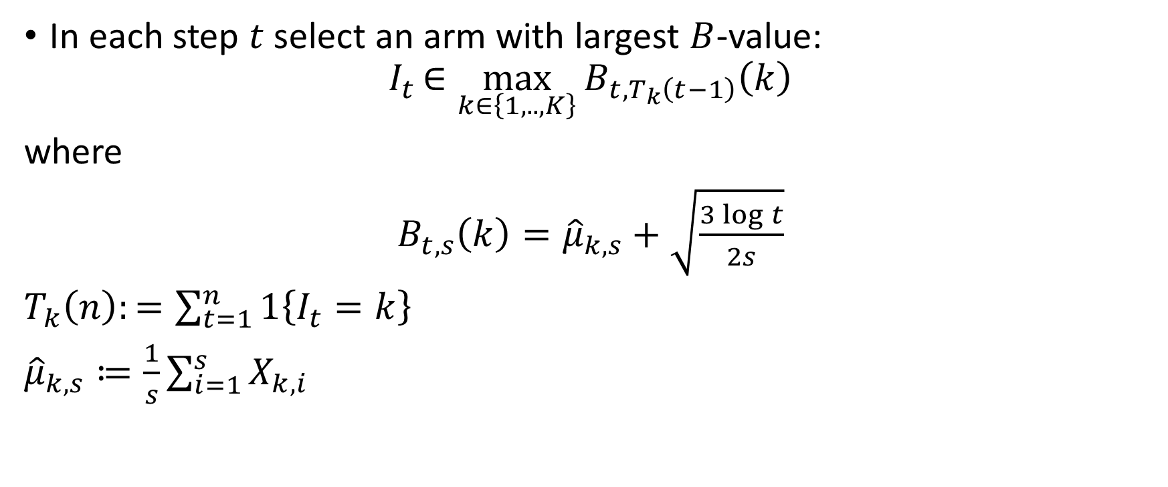
Upper confidence bounds algorithm
In each step $t$ select an arm with largest $B$-value:
$$I_{t}∈\max_{k∈\left\{1,..,K\right\}}{B_{t,T_{k}\left(t−1\right)}\left(k\right)}$$
where
$B_{t,s}\left(k\right)={\hat{μ}}_{k,s}+\sqrt{\frac{3\log{t}}{2s}}$
$T_{k}\left(n\right):=\sum_{t=1}^{n}{1\left\{I_{t}=k\right\}}$
${\hat{μ}}_{k,s}≔\frac{1}{s}\sum_{i=1}^{s}{X_{k,i} }$

Slide 15
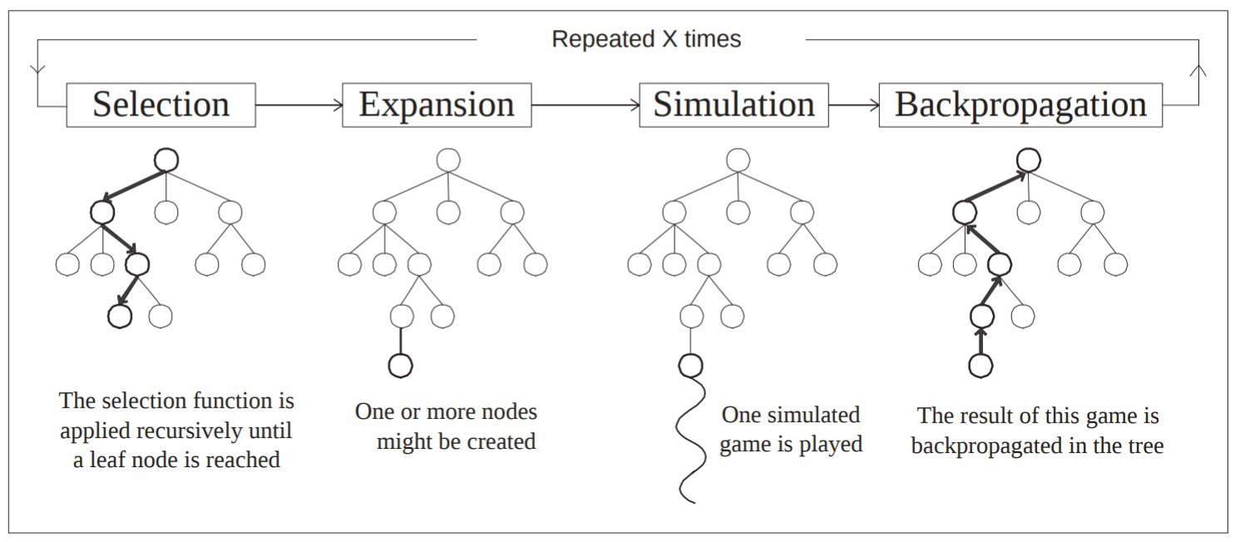
Monte Carlo Tree Search

Slide 16
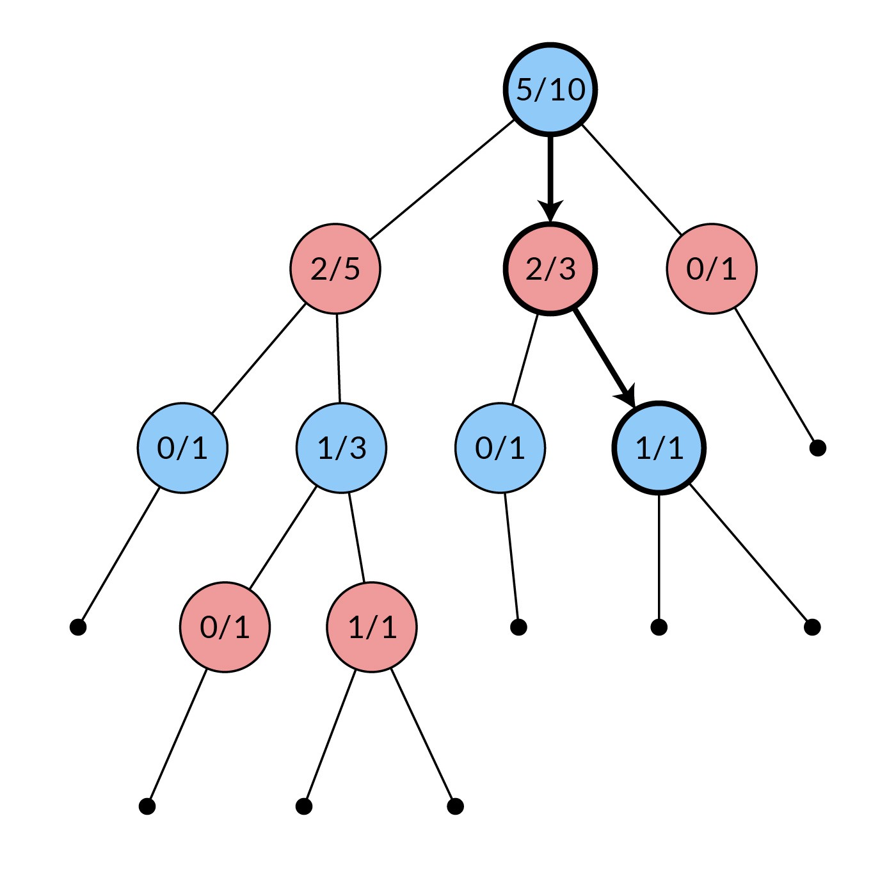



Monte Carlo tree
Monte Carlo tree
We have a neural network $f_{θ}\left(s_{t}\right)$
which will output a value function $v_{θ}\left(s_{t}\right)$
and a probability function $p_{θ}\left(s_{t}\right)$.
$v_{θ}\left(s_{t}\right)∈[−1, 1]$ estimate the win/loss rate of the state $s_{t}$.
$p\left(s_{t}\right)∈{\left[0,1\right]}^{a}$ is the prob. of exploring each action.
w: estimated win or loss
s: number of entering this node
for w/s in each node of MC tree.

Slide 17

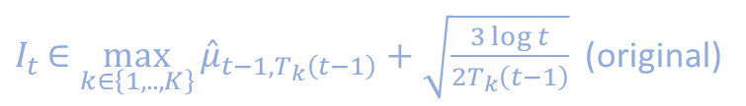
1. Selection
Monte Carlo tree
w: estimated win or loss
s: number of entering this node
for w/s in each node of MC tree.
1. Starting from the root node of the search tree
2. Select and enter child node by UCB
$a_{t}=\max_{a}\left(\frac{w_{i}}{s_{i}}+\frac{P\left(s,a\right)}{1+N\left(s,a\right)}\right)$
$I_{t}∈\max_{k∈\left\{1,..,K\right\}}{{\hat{μ}}_{t−1,T_{k}\left(t−1\right)}+\sqrt{\frac{3\log{t}}{2T_{k}\left(t−1\right)}}}$ (original)
3. Repeat (2.) until reaching the leaf node

Slide 18
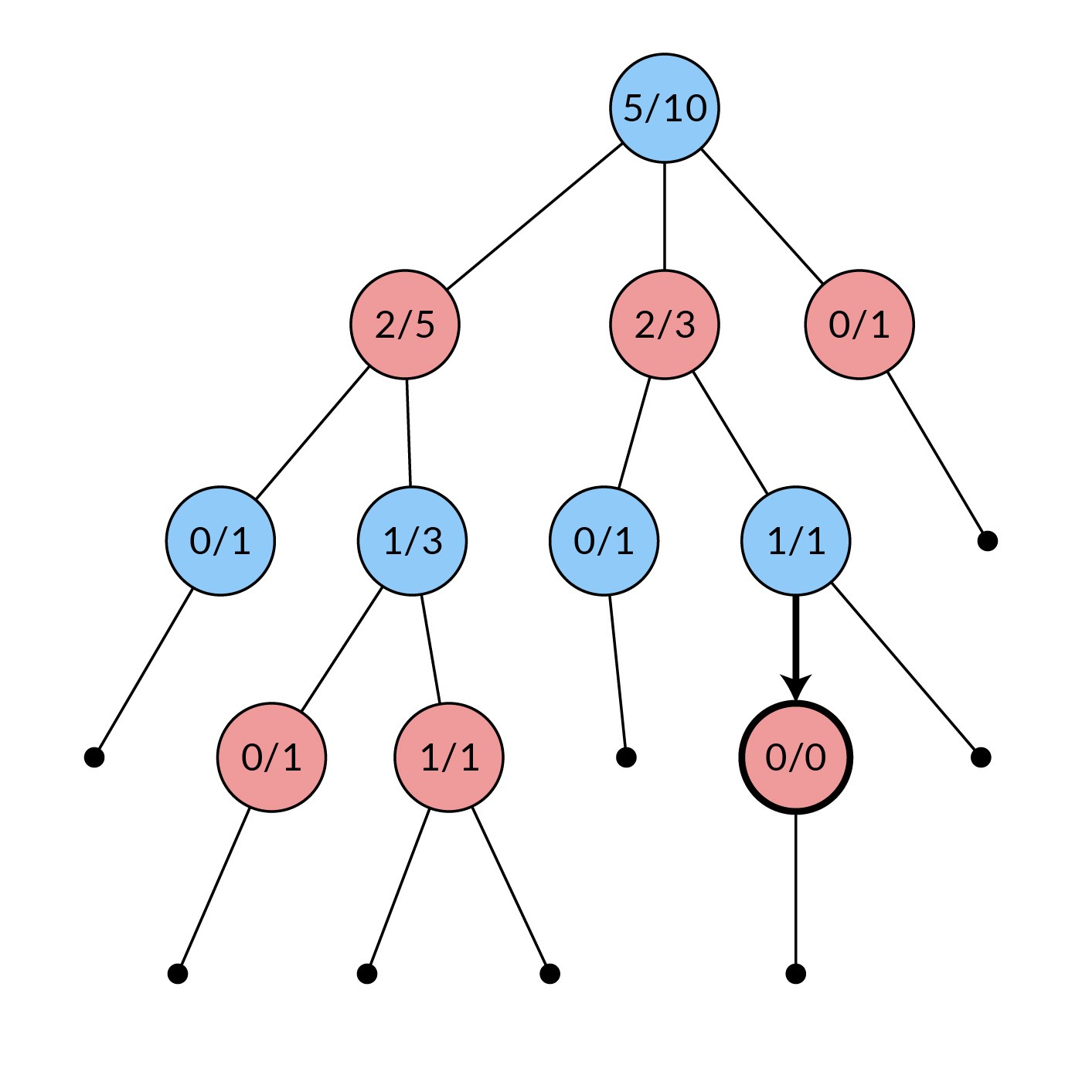
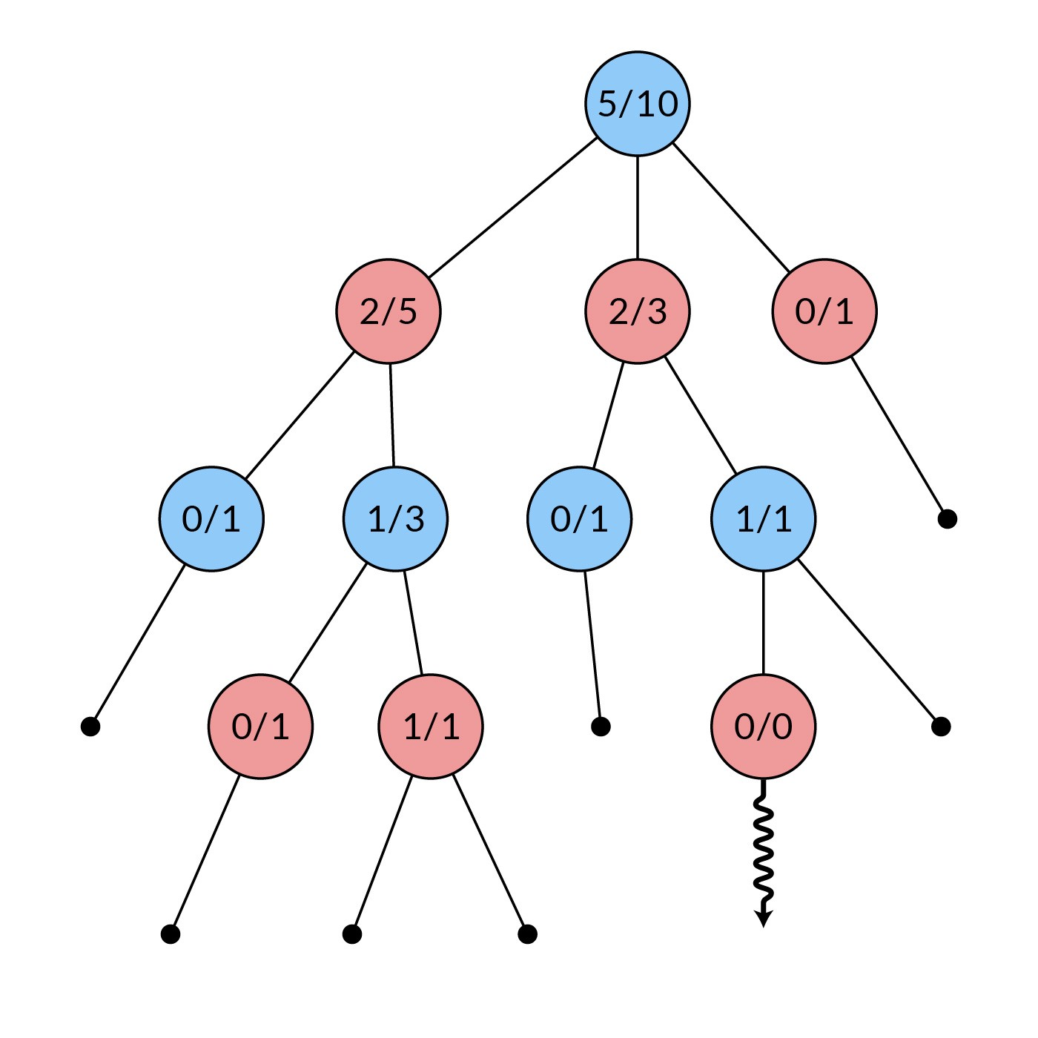
2. Expansion and 3. stimulation
Expand
Stimulate

Slide 19
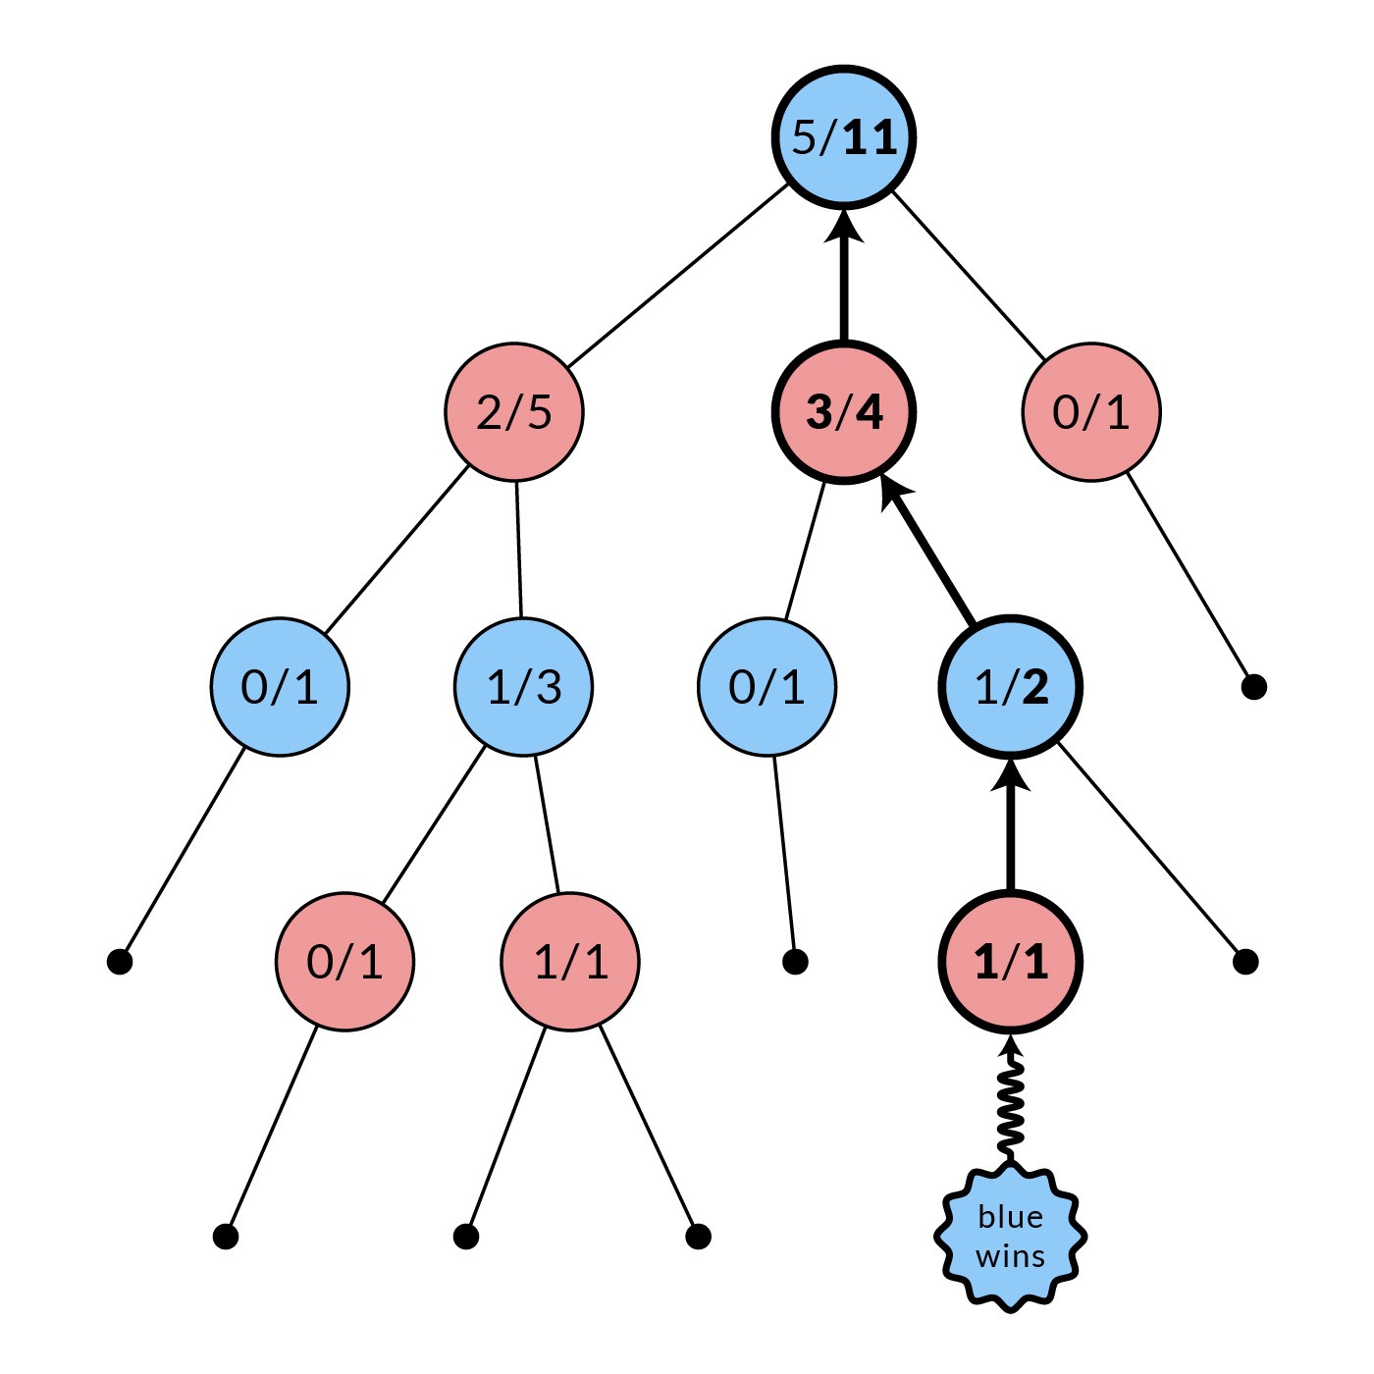
4. Back Propagation
w: number of winning
s: number of entering this node
for w/s in each node of MC tree.
1. After getting the stimulated result
2. Update $w/s$ for parent of current node
3. Repeat (2.) until reaching the root node

Slide 20
Monte Carlo Tree Search
Repeat 1600 times!

Slide 21
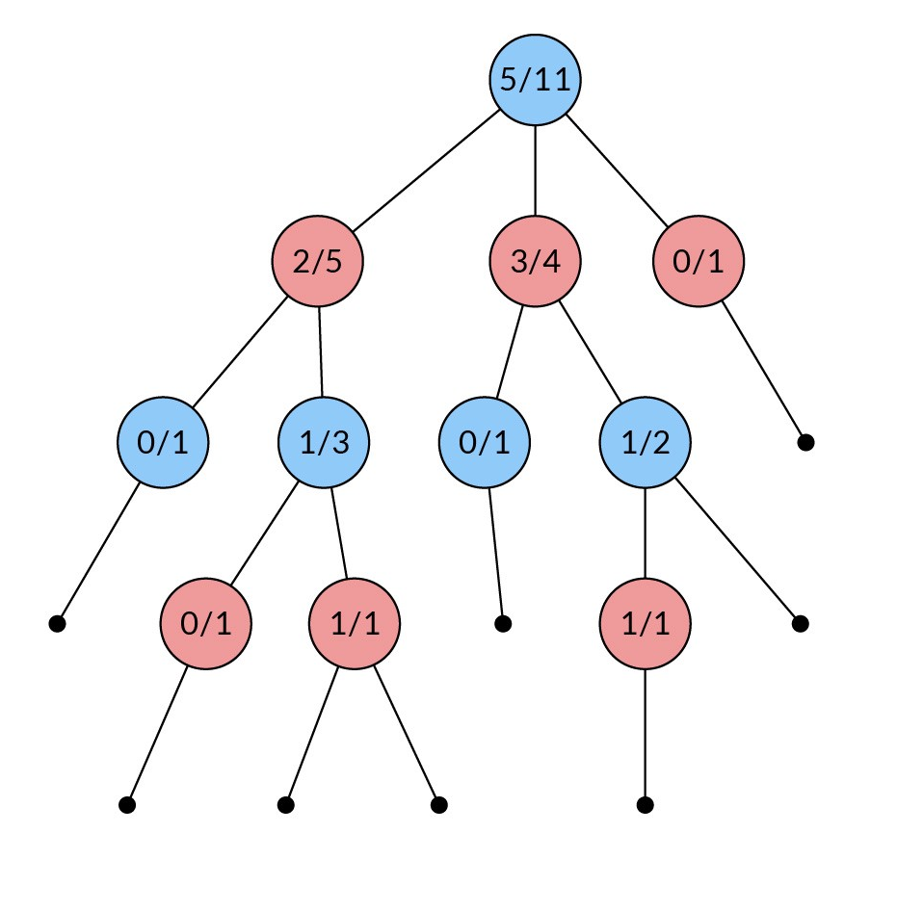



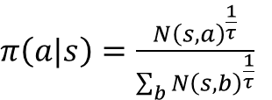
Play!
Select moves by $π$:
$π\left(a|s\right)=\frac{N{\left(s,a\right)}^{\frac{1}{τ}}}{\sum_{b}{N{\left(s,b\right)}^{\frac{1}{τ}}}}$
Small $τ$ encourages exploration
Large $τ$ encourages exploitation

Slide 22
Multi-armed bandit + MCTS= AlphaGO
Monte Carlo tree
因為沒辦法只透過現在的state衡量現在的勝率，所以透過UCB algorithm找到\探索重要的未來，藉由重要的未來來衡量現在的勝率。

Slide 23
Thanks!

